Slide 1
Proposed Annexation Open House

Slide 2
Welcome to Spruce Grove’s Proposed Annexation Open House

Slide 3
What is Annexation?
Annexation is a provincially-regulated process of adjusting the boundaries between two municipalities. Resulting in one municipality becoming smaller and the other municipality becoming larger.

Slide 4
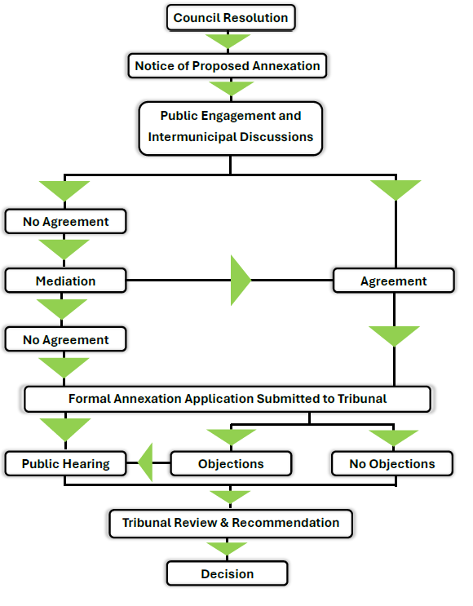
What is the Annexation Process?
February 26, 2024
We Are Here
9 – 12 Months (City)
10 – 13 Months (Province)

Slide 5
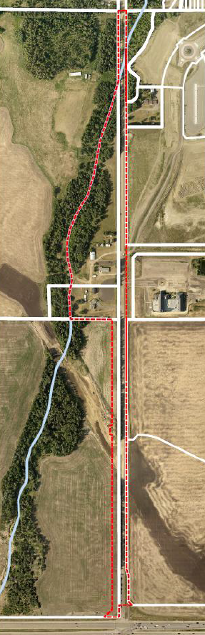
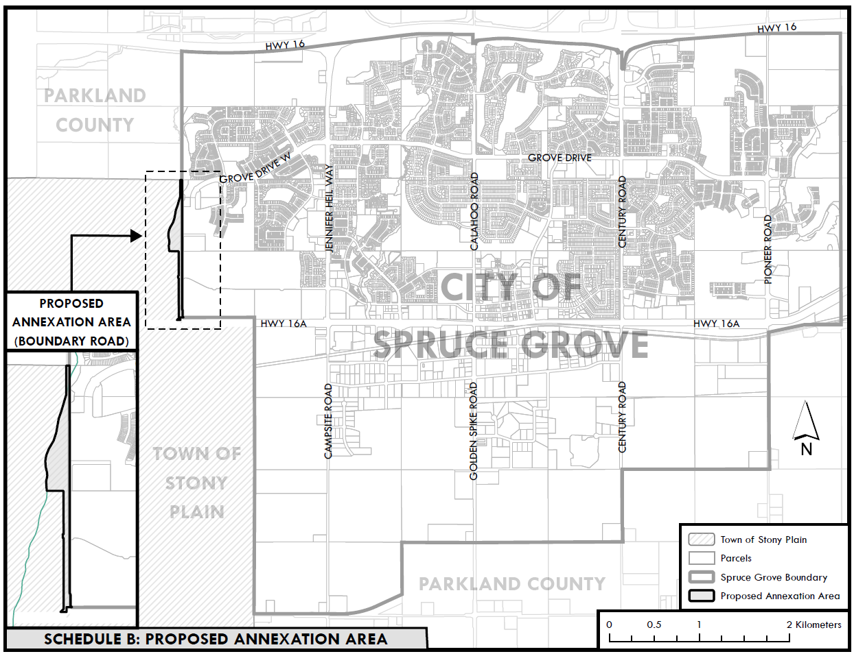
What is the City Proposing to Annex?
Spruce Grove is proposing to annex approximately
9.6 hectares (23.7 acres) of land from Stony Plain.

Slide 6
Why is the City Proposing to
Annex?
In 2019, Spruce Grove agreed to pause annexing this area.
In the last 5 years, significant residential development has occurred in the northwest sector of the City.
The additional population is creating growth pressure and transportation demand.
Spruce Grove proposes to extend Grove Drive through Boundary Road to Highway 16A
The road extension will:
          reduce traffic congestion;
          provide alternative emergency access; and
          offer more efficient transit routes.

Slide 7
How has Growth Impacted our City?
City-Wide
Between 2016 & 2023, population increased by 5,345 people
(16% increase and annual rate of 2.1%).
Northwest Sector
Between 2016 & 2023, the northwest sector’s population increased by 1,874 people (33% increase and annual rate of 4.1%).
Assumptions
Northwest sector’s growth was almost double that of the annual rate of growth for the entire city.
At 4.1% growth, the northwest sector will be completely full by 2039.
Limited access to the northwest sector continues to impact residents.

Slide 8
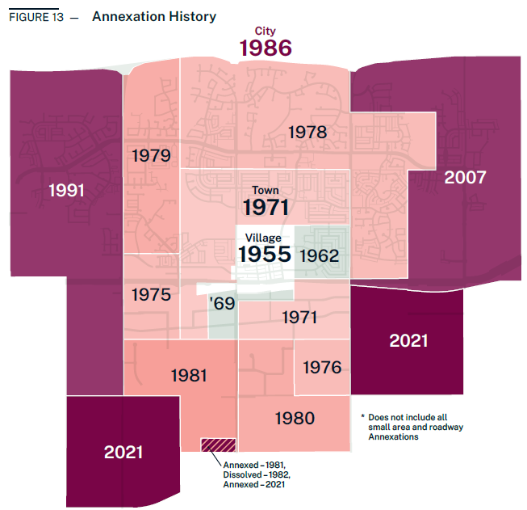
How has the City Annexed Previously?

Slide 9
Next Steps?
Discussions continue with Town of Stony Plain.
A report will be prepared and submitted Land and Property Rights Tribunal including:
            Justification of the proposed annexation;
            Summary of the results of the discussions, consultation and public engagement;
            Required technical information; and
            Any other information needed.
The Tribunal will make a recommendation to the Province.
The Province will make the final decision on the proposed annexation request.

Slide 10
Thank you for Coming.
Please Leave a Comment
& Have Your Say.

